Slide 1
The role of Earth Observations in
the enhancing security in the Water-Food Nexus
August 29, 2012
GEOSS S&T Conference
Bonn, Germany
Rick Lawford

Slide 2
Water:
Water is the entry point for Sustainable Development (SD) and the
Green Economy. Without water security it will not be possible to
realize these SD Goals and to cope with the wide range of economic
and social risks that will arise from climate change, disasters and
manipulation by humans of the Earth’s surface.
Water security requires the ability to:
Map the availability and quality of surface and sub-surface waters,
Measure and understand how the water cycle varies and changes,
Predict how the availability and quality of water resources will
change on a range of time and space scales,
Support the integrated planning and management of water
resources both nationally, internationally, and globally,
- Implement new technologies for water discovery and supply.
This can only be achieved with timely, coordinated
observations!

Slide 3
Water security challenges for sustainable agriculture
Cumulative Daily Withdrawal to Demand Ratio (Hanasaki, 2008)
Changing climate, increasing extremes
Increasing importance of irrigation, but increasing competition for ‘blue’ water;
Increasing pressures on water quality and habitats, need for ‘beneficial management practices’
Changing role for agriculture in providing ecosystem goods and services

Slide 4
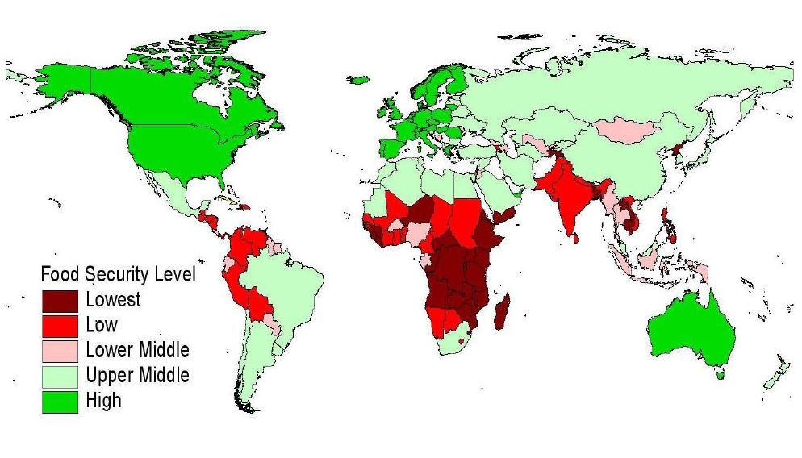
Some Risks in Food Security (with implications for
water):
the growing demand for food (arising from growing
populations and dietary expectations)
(2000: Average: 2,700 Kcal/day with GDP/cap of $5,000
2050: Projected Average: 3,300 Kcal/day with GDP/cap of $12,500)
the global economy,
competition with other sectors (e.g., biofuels) for
certain food types,
insufficient water to irrigate in some areas,
no further arable land for development,
soil degradation and water pollution due to
agricultural runoff,
the impacts of drainage and changes to
flood regimes and the global water systems.
Food Security Issues

Slide 5
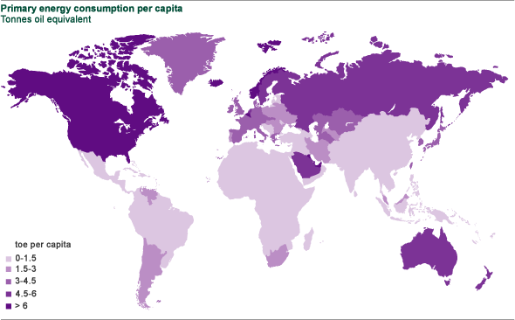
Some Risks in Energy Security (with implications for water
and the environment):
the growing demand for energy
the global economy,
volatility in fossil fuel prices,
excessive use of polluting energy processing techniques
(e.g., fracking for natural gas),
competition for biofuel feedstocks with agriculture,
limits to basic supply of traditional resources,
rejection of nuclear energy,
limited investments to develop infrastructure to use
low-head hydro in meeting energy demands,
.

Slide 6
Needed: New approaches to governance:
  Governance: the systems used for decision making and the allocation of responsibility and accountability.
  Governance structures should:
  - enable issues related to water, energy, food and environment to be considered within a single forum,
  - involve experts from different levels of government to interact with stakeholders and the public in consultative and decision making processes,
  Seek fora where state or national leads can provide feedback which would be helpful to develop plans for basin-wide management plans.
  Maximize the use of Earth Observations and scenarios to make the decision process as transparent as possible.

Slide 7
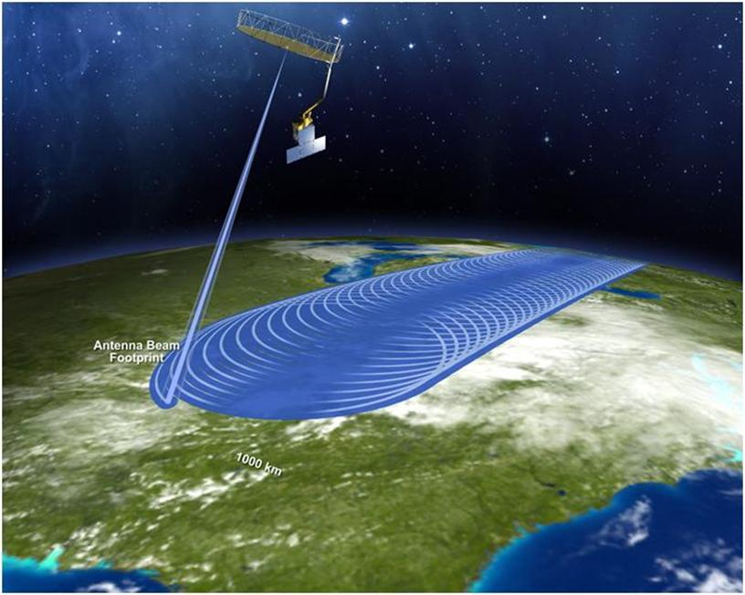
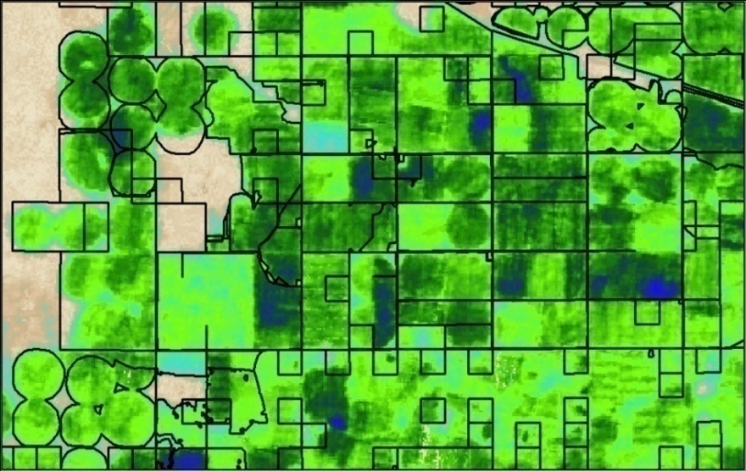
Improved information can also lead to more effective
irrigation programmes
Improved precipitation
monitoring and forecasting
(Ethiopia)
NASA SMAP
satellite
Improved soil moisture monitoring
to detect dry conditions and take
appropriate action.
Use of ET measurements to monitor
the use of water over the growing
season.

Slide 8
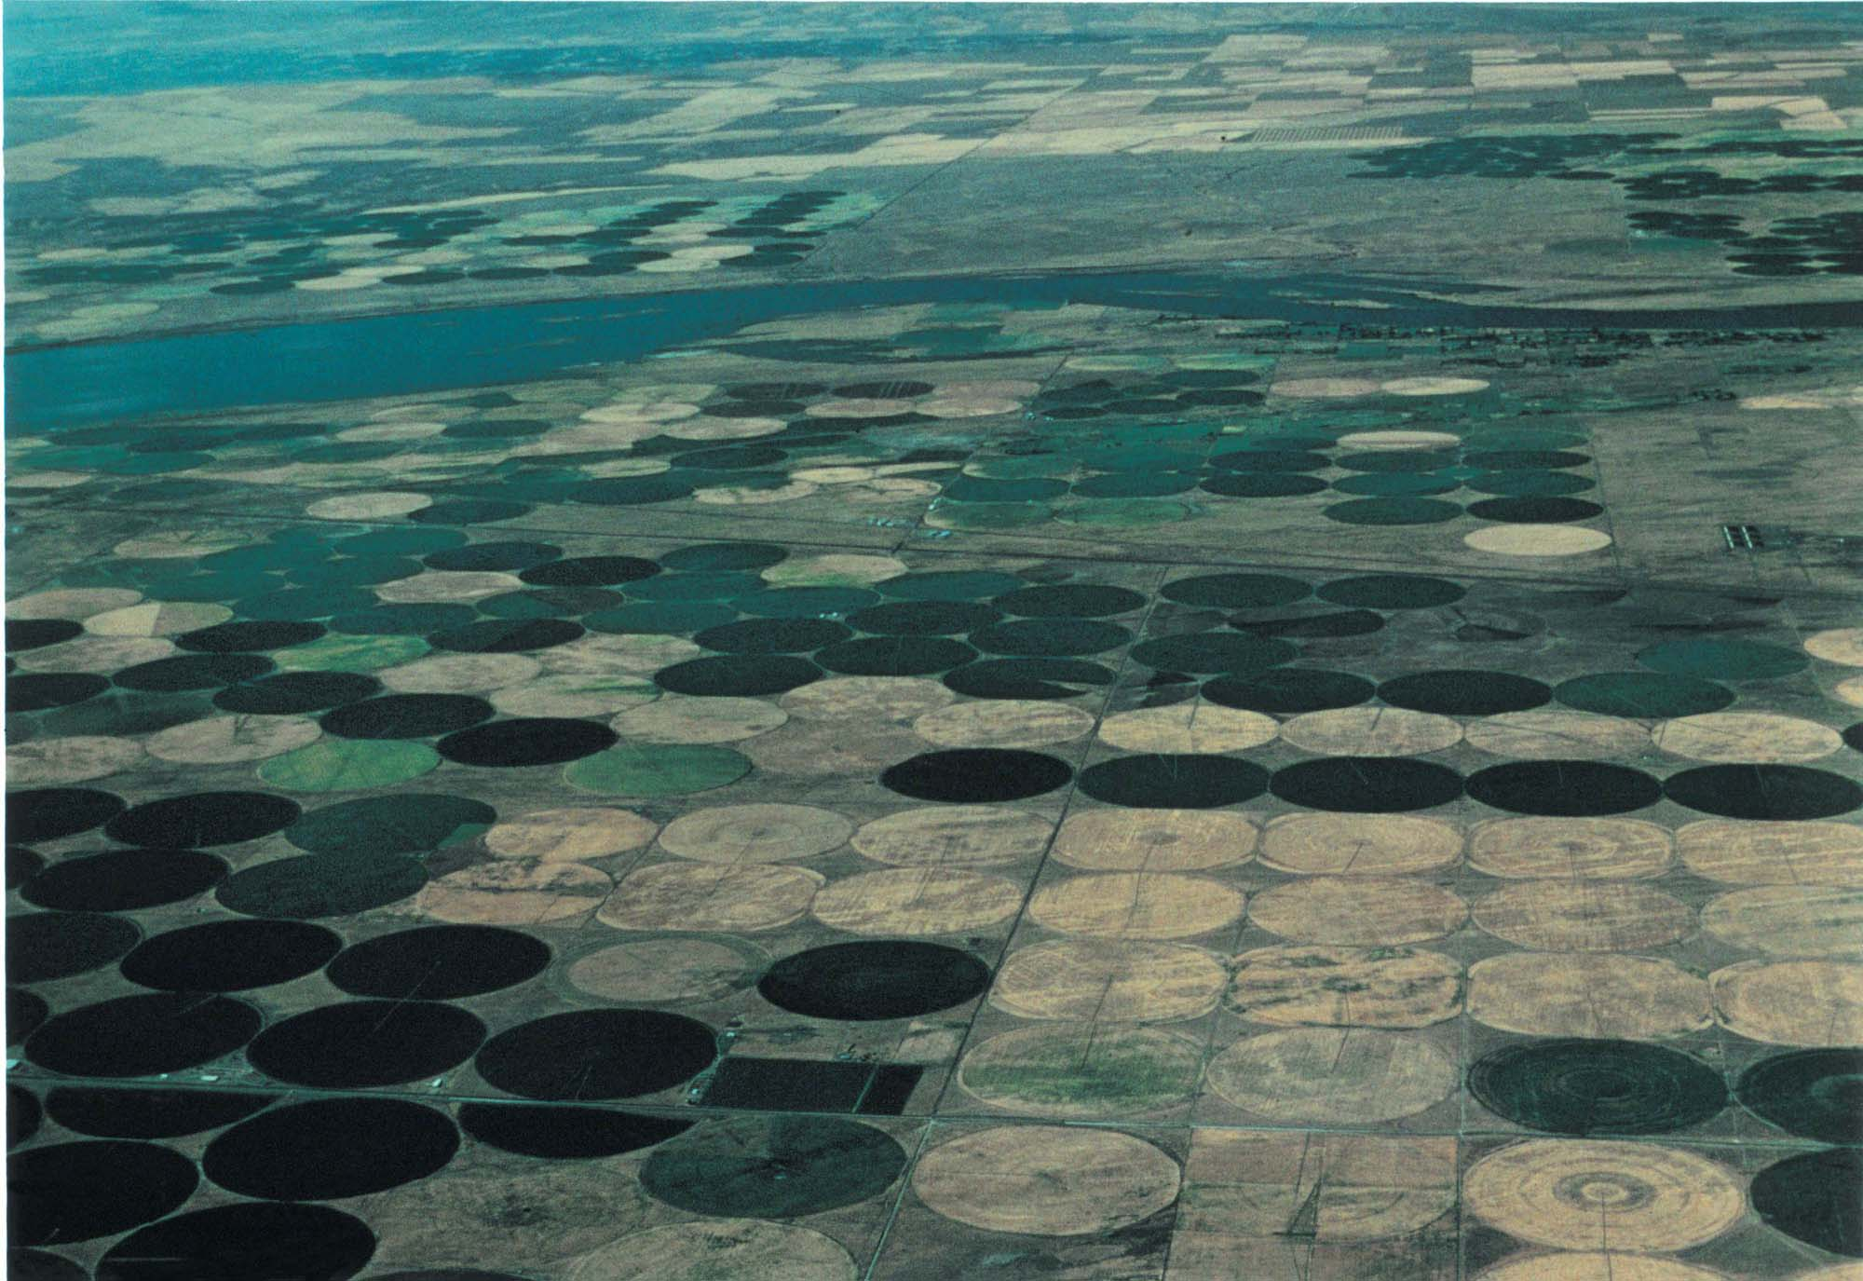
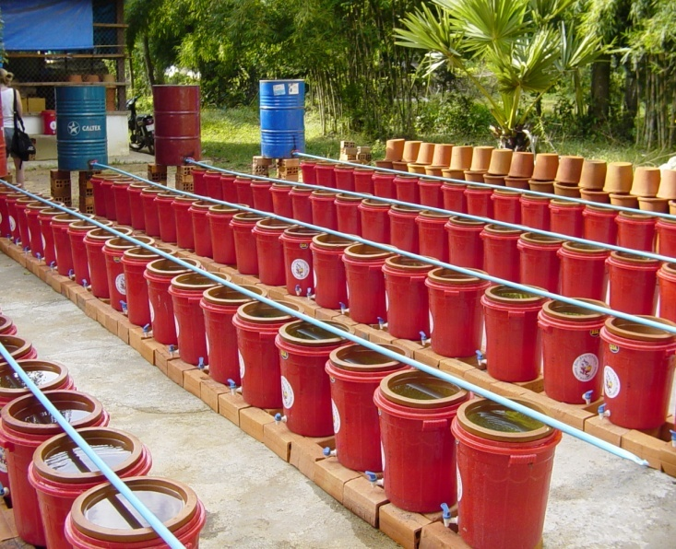
Irrigation: Local solutions can help to
optimize the Use of Water
Irrigation has been responsible for
increasing yields in many parts of the
world. However, it has not always been
used efficiently as evidenced by:
- large areas of saline soils resulting from
those soils being saturated for too long.
- quality water has been used for irrigation
at the expense of higher value services.
unknown effects of poor quality irrigation
water on food quality.
high energy costs of some irrigation systems.
Treadle pumps do not
require costly energy
inputs.
Drip Irrigation reduces
water use and increases
crop yield
Ceramic water purifiier
provide cleaner water for
various applications

Slide 9

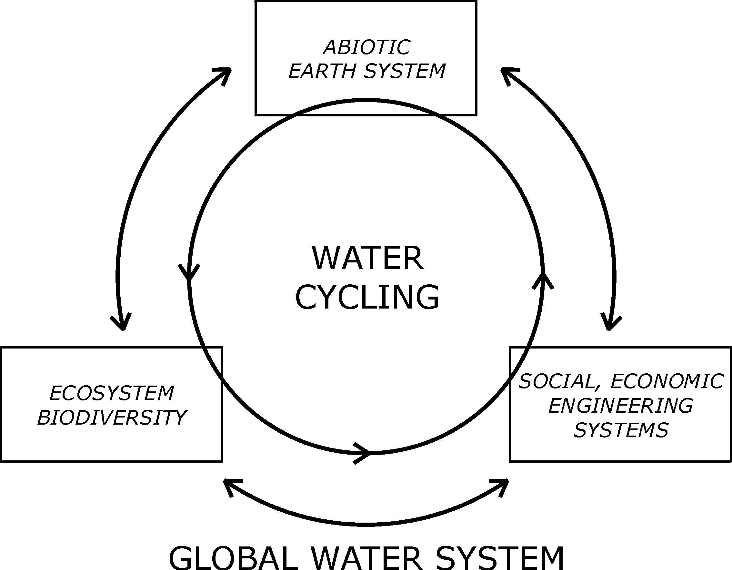

THE GLOBAL WATER SYSTEM (GWS)
Hypothesis:
Humans are changing the global water cycle, the associated biogeochemical cycles, and the biological components of the Global Water System in ways that we have never been occurred before.
GWSP Open Science Conference, UNH, Oct. 7 2003
Notes:
Sources:
World map: modified from Buddemeier RW, Smith SV, Swaney DP and Crossland CJ (eds.) 2002. The role of the coastal ocean in the disturbed nutrient and carbon cycles. LOICZ Reports & Studies No. 24, ii + 83 pp., LOICZ, Texel, The Netherlands. (Figure 2.1, p.14.)
Notes:
The map shows the distribution of major river basins and their discharge points across climatic regions. [Pink, light blue and medium blue shades represent tropical, temperate and polar regions defined by sea surface temperature. The green regions are major and medium sized land drainage basins with associated biogeochemical budget sites shown in yellow.]

Slide 10
GWSP: Integrated Study Areas,
Governance &
adaptation Strategies
Global Scale Initiative:
Ranking of threats to the GWS, States
and Trajectories of Change
Simulation modelling
& scenarios
Observations
Climate change
2. Global Catchment Initiative:
Bringing the global perspective to
river basin research & management
METHODS & TOOLS
SPECIAL INTERESTS
3. Global Water Needs Initiative: Humans and
Nature
Policy Outreach & Capacity Building
Notes:
GSI: Constructed, Developed, translated
GCI: Define a new set of global-oriented questions for river basin researchers and managers. “A GWS research template” Address and discuss these questions in an international intercomparison of river basins.
Educate water managers & other stakeholders about the importance of global change on the catchment scale.
What are the types and magnitude of potential changes in particular catchments due to climate change?
GWNI: Develop a global consensus on assessment of environmental flow needs.
Valuate freshwater ecosystem goods and services.
Devise strategies for harmonising water needs of humans and nature

Slide 11
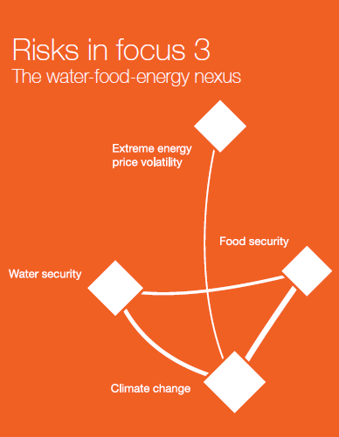
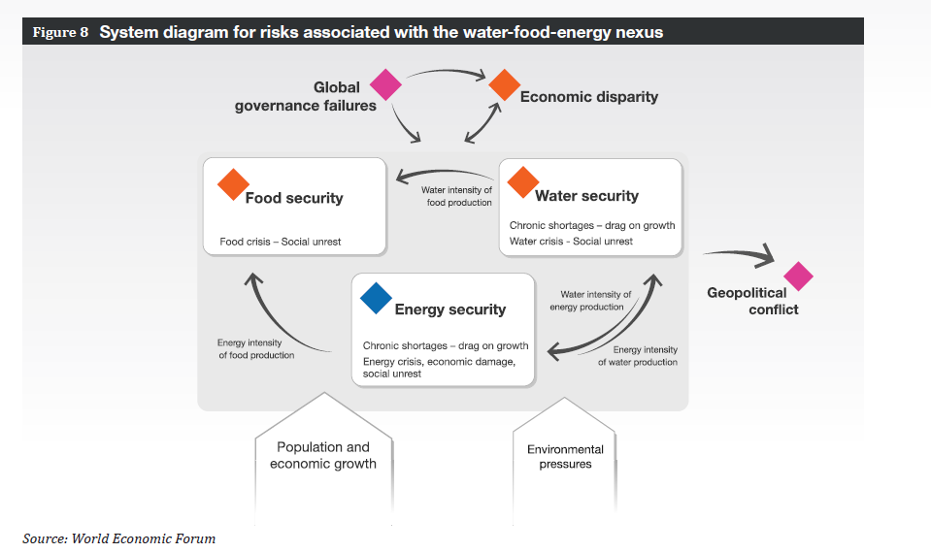
Three major risks for the global economy:
The macroeconomic balances nexus
The illegal economy nexus
The water-food-energy nexus
(2011 World Economic Forum)

Slide 12
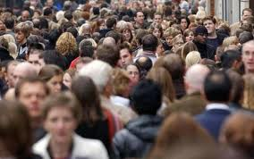
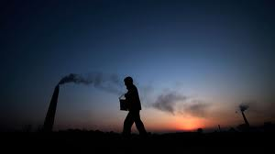
WEF Context
Climate change
  Mitigation – energy
  Adaptation – land and water
Growing population
  Poverty
  Health
Management
  Enormous opportunities for higher efficiency
  Study of the whole complex system
  Understanding interactions – it is all about feedbacks
Scale
  1.4 billion people without access to electricity
  3 billion with out access to modern cooking and heating
  900 million people without access to safe drinking water
  2.6 billion do not have sanitation
  900 million people are chronically hungry
  2 billion people lack food security
IISD, Winnipeg 2012
Slobodan P. Simonović

Slide 13
Some of the information needed to address these issues is implicit in
The four questions that were used in the design of a questionnaire.
Four core science questions or hypothesis that will be considered in
this study include:
How are issues related to the integrated water-energy-food (W-E-F) security issues
affecting major river basins? (How important is the issue?)
How are major river basins being managed in order to address the emerging
challenges arising from water-energy –food security issues and the effects of
changes in the climate, demographics and economies of the world? (How are basins
being managed to increase W-E-F tradeoffs?)
How do water-energy-food security strategies/mechanisms link separate and
remote river basins and affect their physical, socio-economic, ecological and
governance status? (How far-reaching are effects in one basin?)
How well are current approaches to governance and management addressing
the W-E-F issues and does a basis exist for recommending changes for the future?
(Do we need to change our approaches to water management?)

Slide 14
Experts from twenty basins were initially selected to receive questionnaires. Approximately 80 questionnaires were sent to experts and practitioners in the following basins:
Response Received:
Amudarya River Basin
Danube River Basin
Elbe River Basin
Hexi Corridor Inland Basins (China)
Huai River Basin
Incomati Basin
Jordan River Basin
Lake Winnipeg Basin
Okavango River basin
Mekong River Basin
Murray Darling Basin
Volta River Basin
Yellow River Basin.
No Response received:
(7 basins)

Slide 15
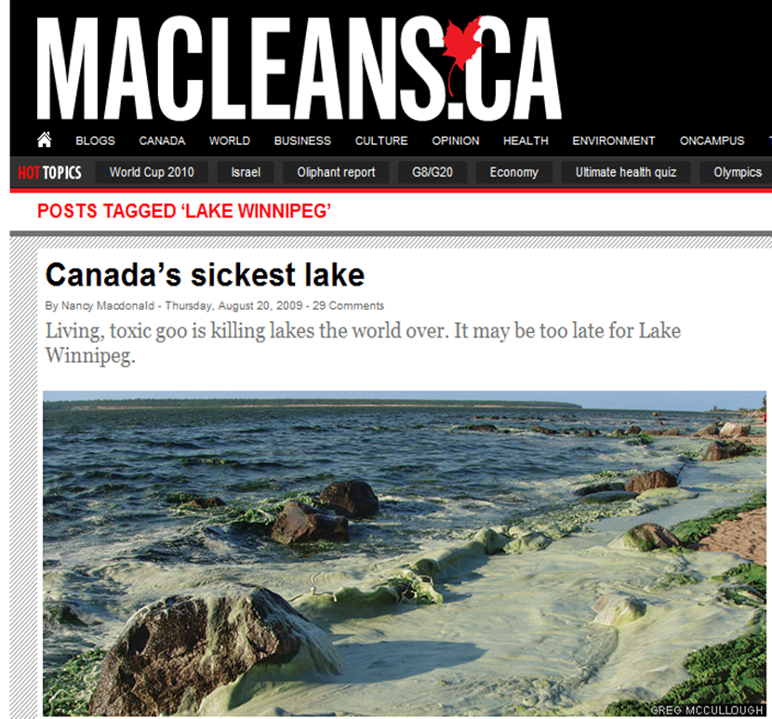
Lake Winnipeg – its physical setting

Slide 16
Lake Winnipeg Basin – its role in the regional economy
Global
Energy and Food outputs in the Basin:
Largest Population Centres:
Calgary – 1,214,839
Edmonton – 1,159, 869
Winnipeg – 730, 018
Hydroelectricity - > $1 billion per year
Oil and gas are being extracted from the
reserves in Saskatchewan, North Dakota
and Manitoba. Water is used for fraking
and for other aspects of the mining
Operation.
Manitoba exports $4.7 billion in agricultural produce to 178 countries.
Continental
Local
Water
Energy
Food

Slide 17
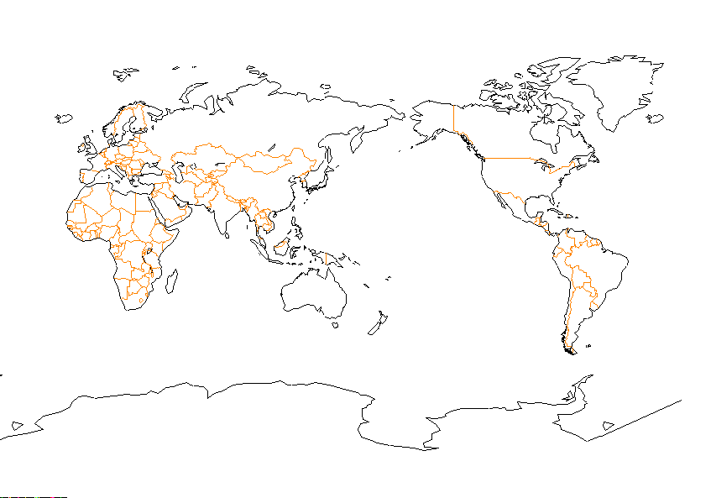
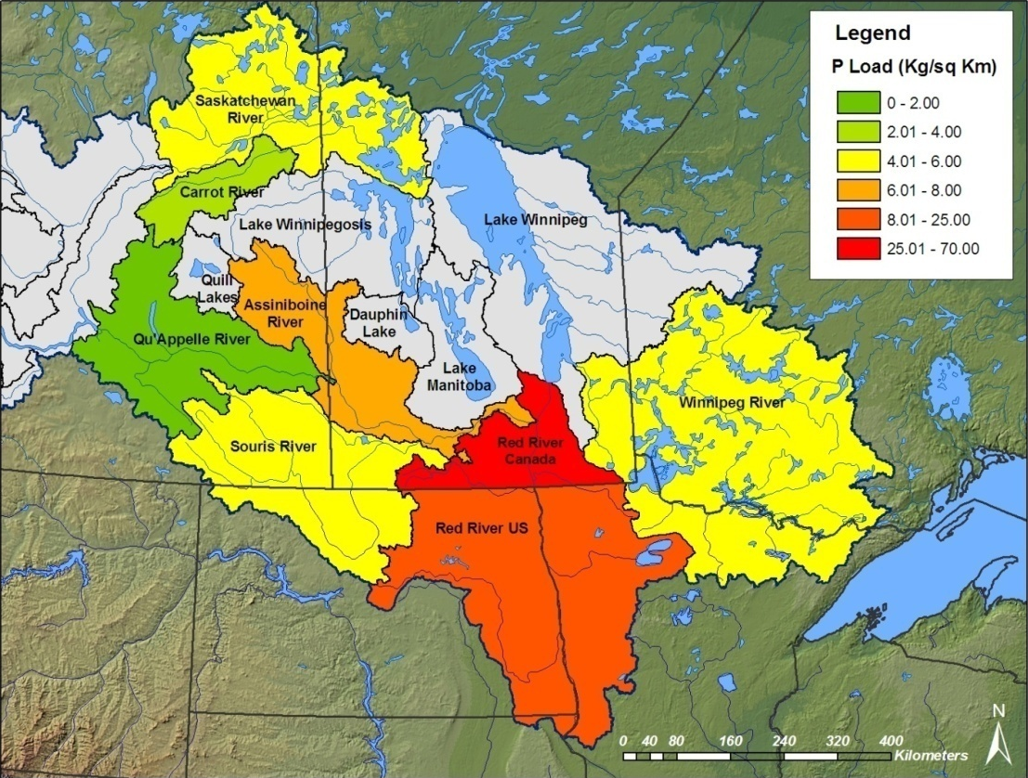
Virtual water is being exported in the food.
Indirect Effects
1.5
5.1
1.9
After Oki (2002)
Virtual water (km3/y)
imported to Japan
by food imports.
42.7
10.5
2.6
Manitoba “exports” ~12.2 Km3/yr
In virtual water through food
exports.
The use of water in oil extraction has a similar footprint but hasn’t received the same attention.
The phosphorous and nitrogen used in fertilizer are also being exported. Phosphorous is a limited resource.

Slide 18
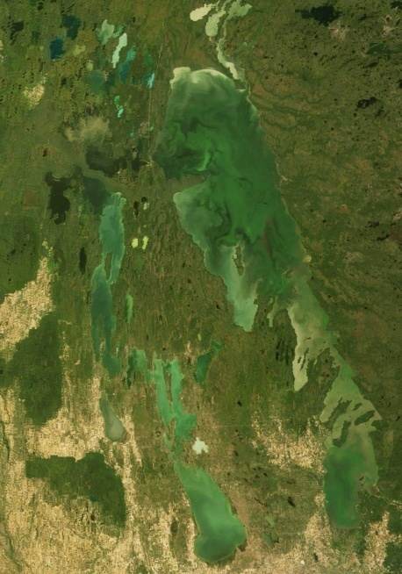
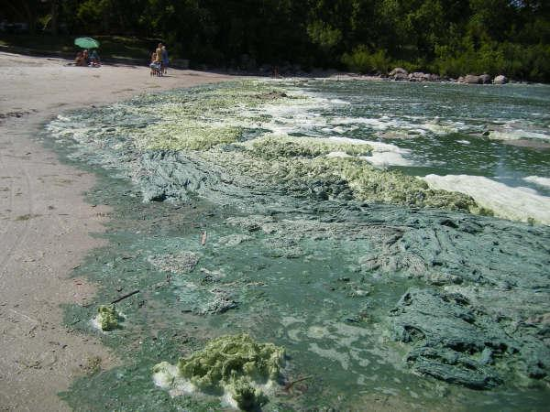
Challenges of the WEF Nexus
The Agriculture and Water Dilemma in the Lake Winnipeg Basin:
In order to maintain high production rates farmers often add excess fertilizer to their
crops. These nitrates and phosphates enter the rivers, especially in times of large
runoff and find their way to Lake Winnipeg.
Over the past two decades the effects have been an increasingly large algal
bloom on Lake Winnipeg during the summer. While the agricultural industry reaps
the benefits of this intensive agriculture it is the public who must pay for the
cleanup.
In 2007, the bloom covered
15,000 km² on Lake Winnipeg.

Slide 19
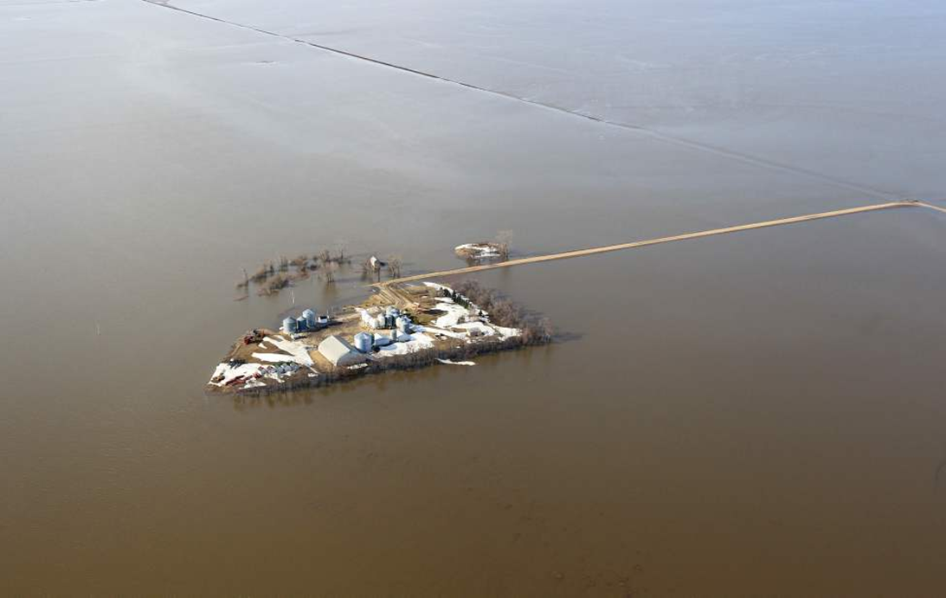
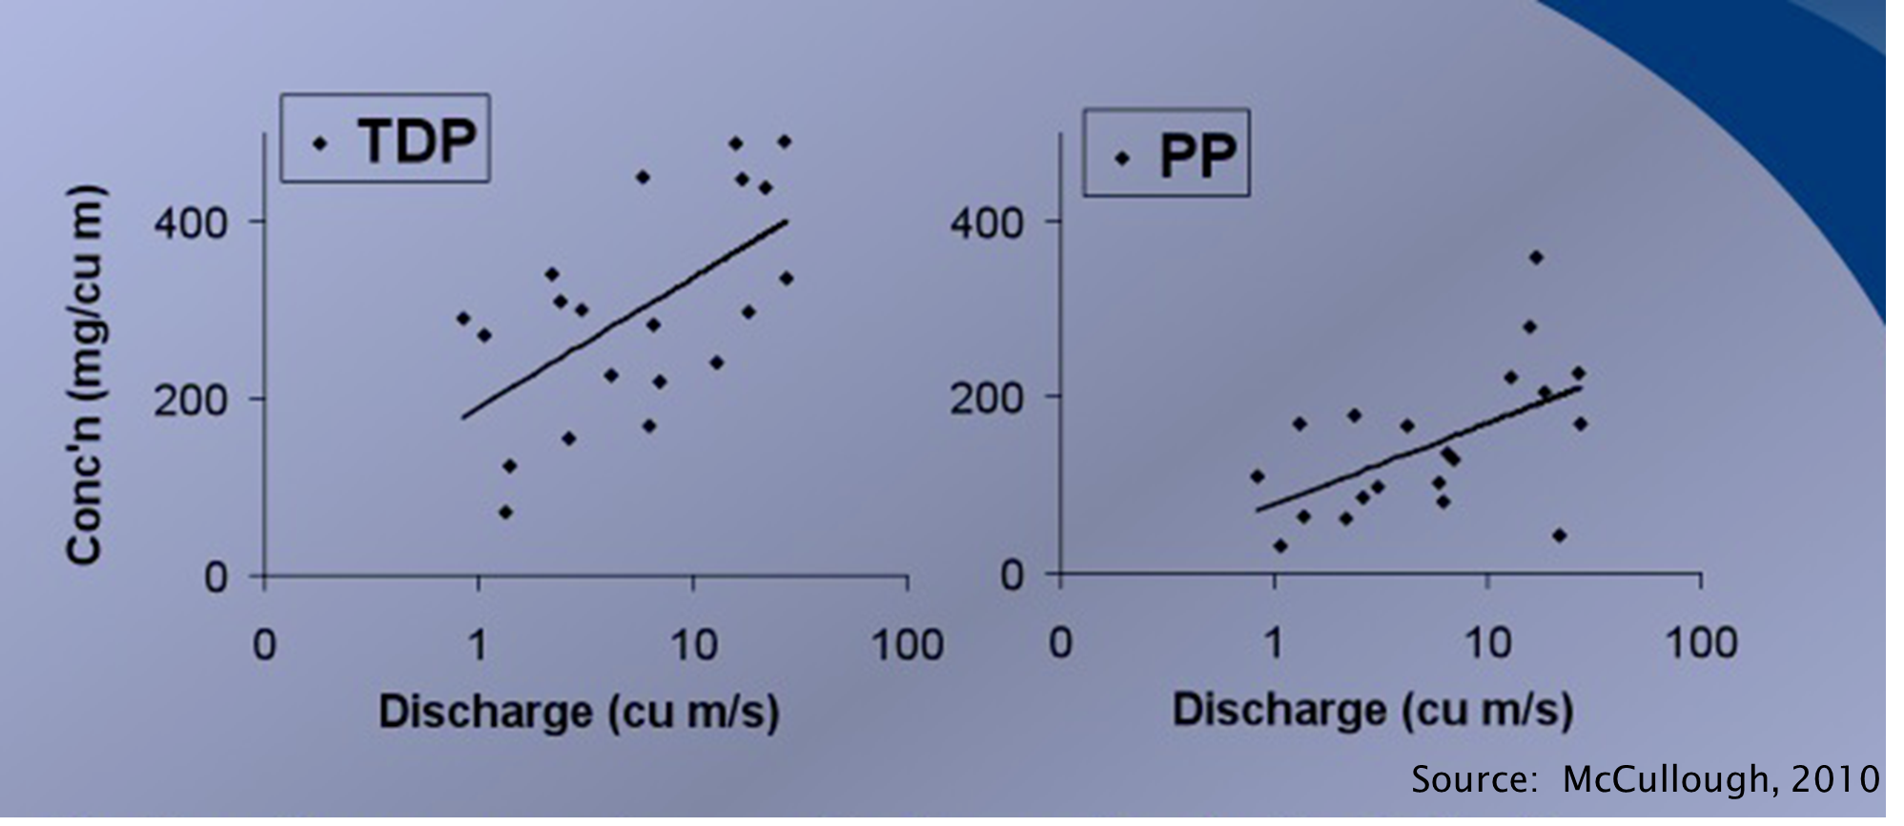
From problem to solution
Water on the landscape:
Floods mobilize the nitrates
and phosphates on the
landscape and moves them
to the lake

Slide 20
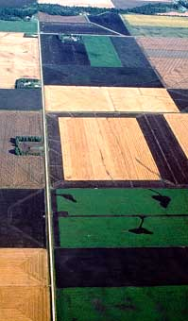
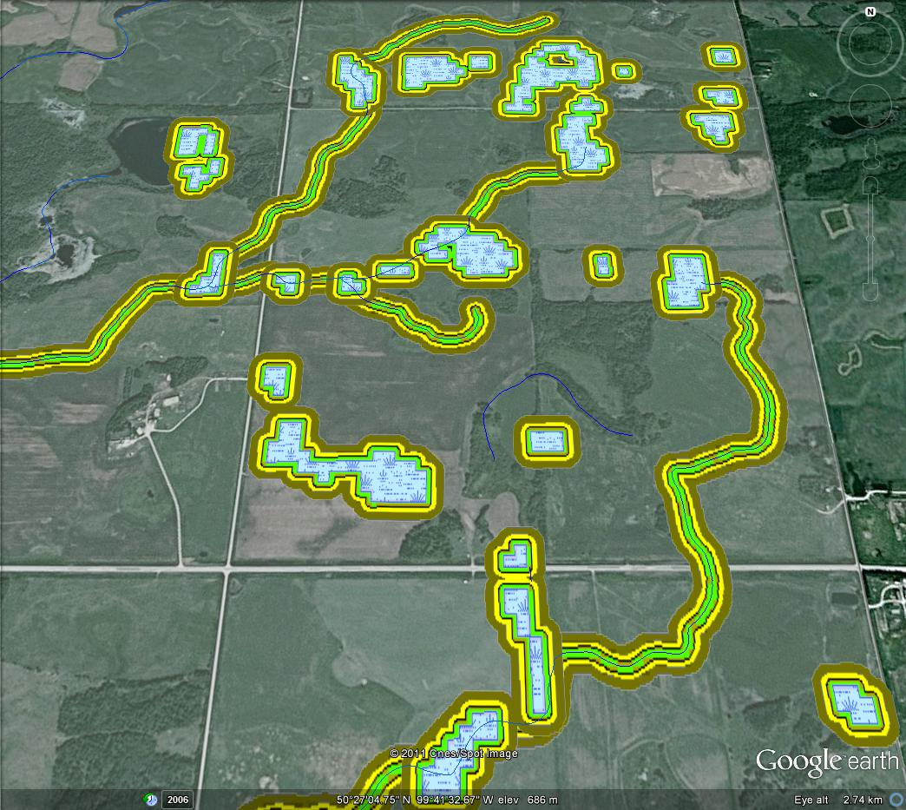
From problem to solution
Water on the landscape:
Controlled water storage on the landscape could reduce fluxes of water and nutrients to the lake.
Vulnerabilities have arisen because:
- Drainage
Deep ditches
Wetland removal

Slide 21
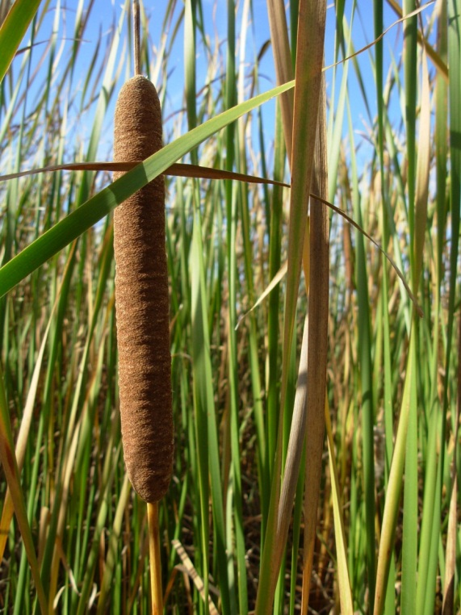
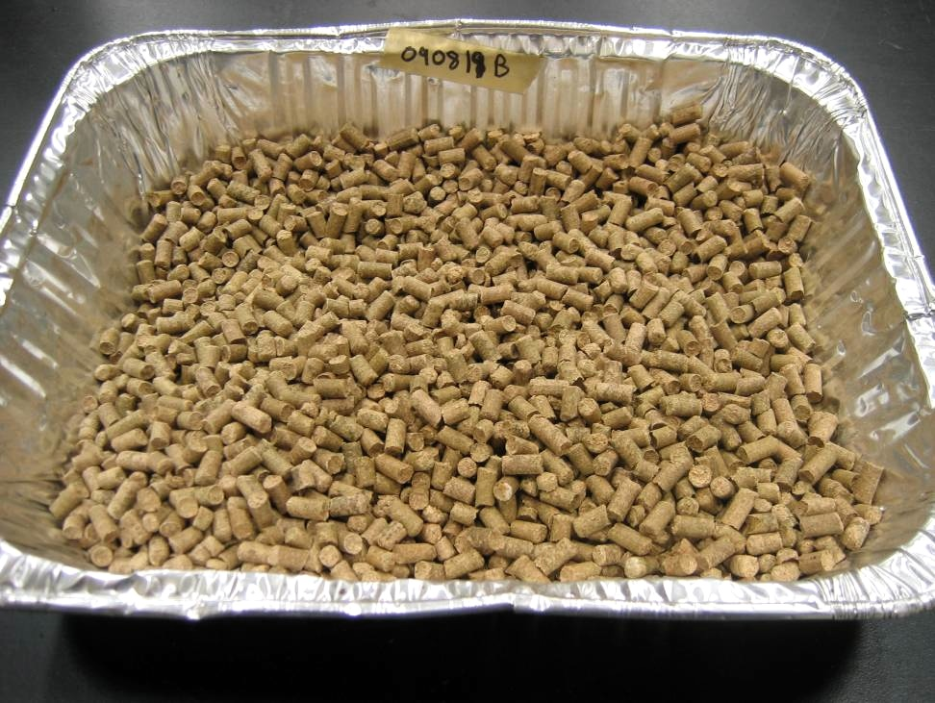
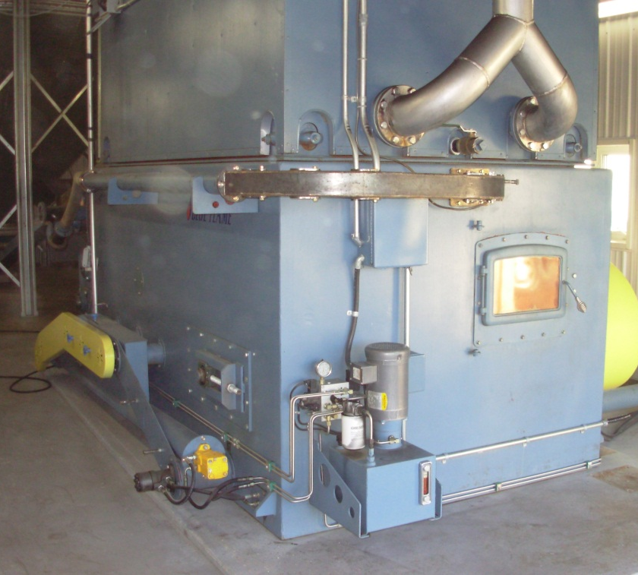
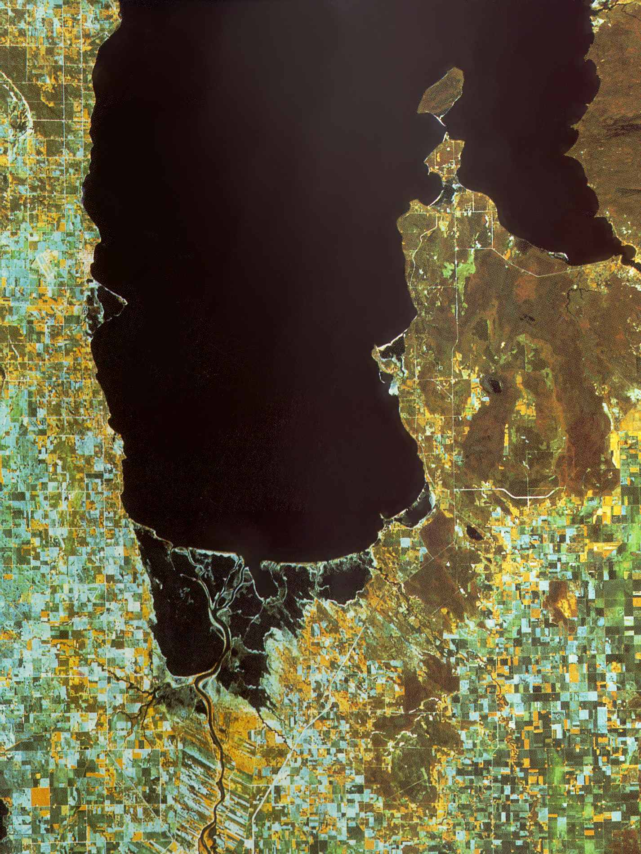
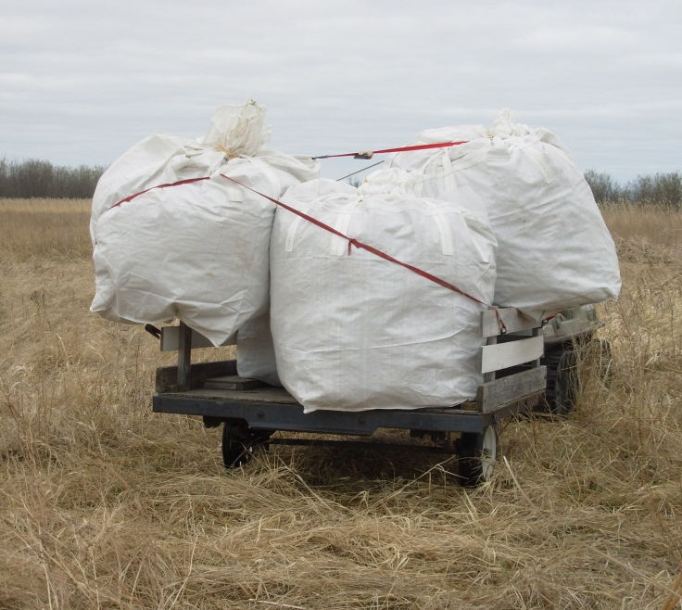
From problem to solution
Water on the landscape:
Vegetation from enhanced storage of surface water can be harvested and used as a source of new industrial feedstocks. This could stimulate new local “green” economic activities.
Netley-Libau Marsh
Captured
P N C …
Exported
P N C …
P
ASH Recovery

Slide 22
Observations from the GWSP Global Catchment Initiative Phase II
(Based on Survey responses from 11 basins):
Some key issues arising from the analysis of survey results:
- The Challenge of Integration
- The Political and Policy Interface
- The Changing Role of Rivers
Monitoring Change in the Basins
Implications of Energy and Food Production and Consumption
- Data Issues and Integrated data systems
Advancing IWRM (or Integrated Approaches to WM) and Political
Cooperation through Technical Cooperation
- The influence of scale on Implementing IWRM
- Water Management for the Bioeconomy

Slide 23
Energy and food are generally managed separately each with the
goal of maximizing the profit from production for a sector at the
national scale.
FOOD
ENERGY
Meet national needs.
Generate revenue
through export.
Distributed ownership
but relative poor.
Meet national needs.
Generate revenue
through export.
Focused ownership
with a few rich.
Meet regional needs
Enable revenue
generation by exports
in other sectors
Generally subsidized and
government controlled.
Water allocations
determine the amount
available in a given year
to each sector
WATER

Slide 24
Significant areas of overlap exist between the management
needs of water, energy and food.
FOOD
ENERGY
WATER
Some areas where joint risk should be addressed:
Climate change (trends, shifts and extremes)
Economics/ investments
Links to environmental services
Pressures from increasing consumption due to demographics.
Unfortunately, the needs of the environment are not well articulated in
most national policies.

Slide 25
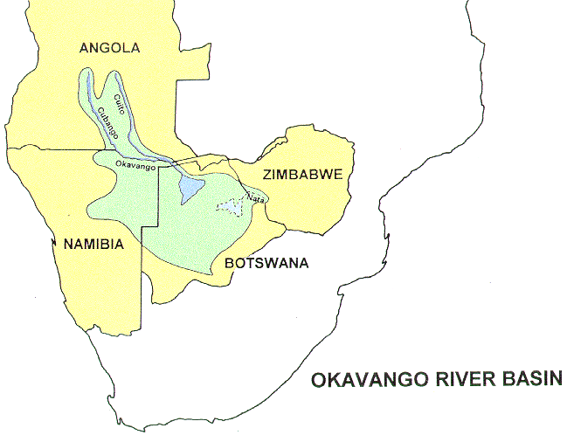
Many basins are transboundary basins. Managing these
basins with only national perspective limits the sharing the benefits
of water for food and energy production and environmental
sustainability The concept of Integrated Water Resources
Management (IWRM) enables joint development of water resources
on a basin by basin basis. But….. it is not easy to implement.

Slide 26
Pathways for Implementing Solutions
Path 1: Increase the contributions of science by linking the science and observational systems to policy objectives through targets and sustainable monitoring.
Path 2: Broaden the ownership of the sustainable development by creating a more open governance process that includes citizens, private sector and all levels of government.
Path 3: Develop water management plans within an Integrated Water Resource Management framework to implement regional bioeconomies that will combine water and land management to maximize contributions to Sustainable Development.
Path 4: Analyze the interactions between land ownership/ management and water impacts to determine where adjustments can be made to improve water availability and quality.
Path 5: Develop a strategy for encouraging investments in water infrastructure that advances the sustainable development of Water for food, energy and environmental security.

Slide 27

WA-01 Integrated Water Information (incl. Floods and Droughts)
Water in the 2012-2015 GEO Work Plan
Components:
C1: Integrated Water-cycle Products and Services*
C2: Information Systems for Hydro-meteorological Extremes (incl. Floods and Droughts)
C3: Information Service for Cold Regions
C4: Global Water-Quality Products and Services
C5: Information System Development and Capacity Building
*
***

Slide 28
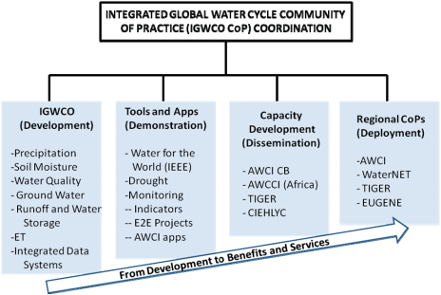
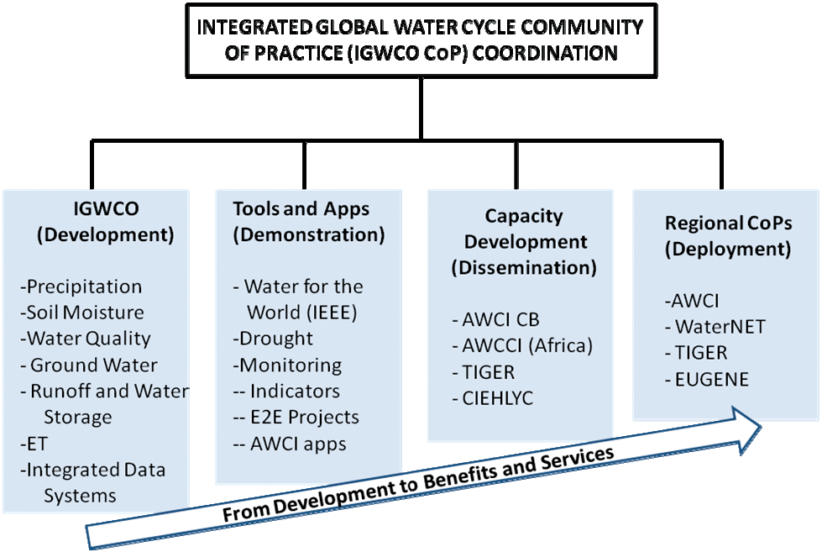

Slide 29
Integrated & Coordinated Approach
Observation
Integration
Work
Bench
Sustained
Education
Framework
Water Cycle Coordination
Integrator
Model
Integration
Management System Integration
Data Integration
& Analysis
Capacity
Building
Cross-SBA/CoP Coordination
Disaster/Health/Energy/Climate/Weather/Agriculture/Forest/Ecosystem/Biodiversity
(Courtesy of Toshio Koike)

Slide 30
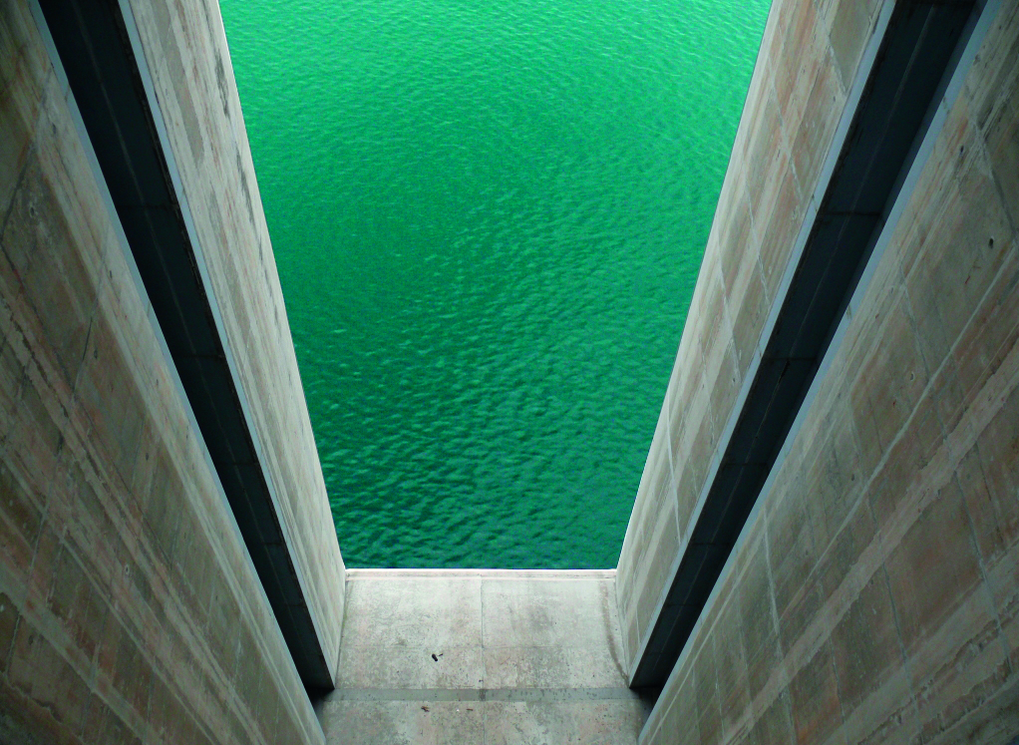
GWSP International Conference
WATER IN THE ANTHROPOCENE:
Challenges for Science & Governance.
Indicators, Thresholds & Uncertainties
of the Global Water System
21-24 May 2013, Bonn, Germany
Conference Theme ❶ Global Water System: Current State & Future Challenges
Conference Theme ❷ Global Dimensions of Change in River Basins
Conference Theme ❸ Balancing Water Needs for Humans and Nature
www.gwsp.org/conference2013.html

